Slide 1
TOURIST ATTRACTIONS OF OUR REGION SOUTH BOHEMIA REGION kleť

Slide 2
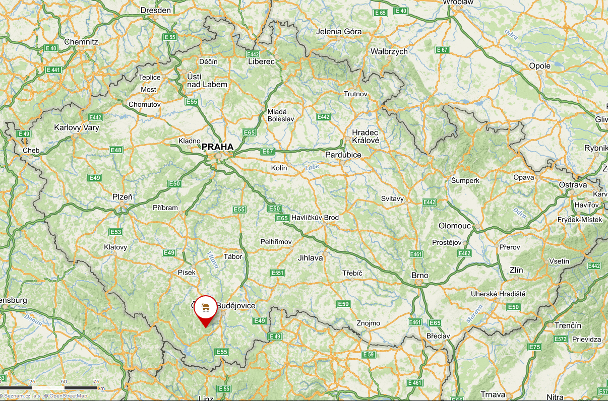
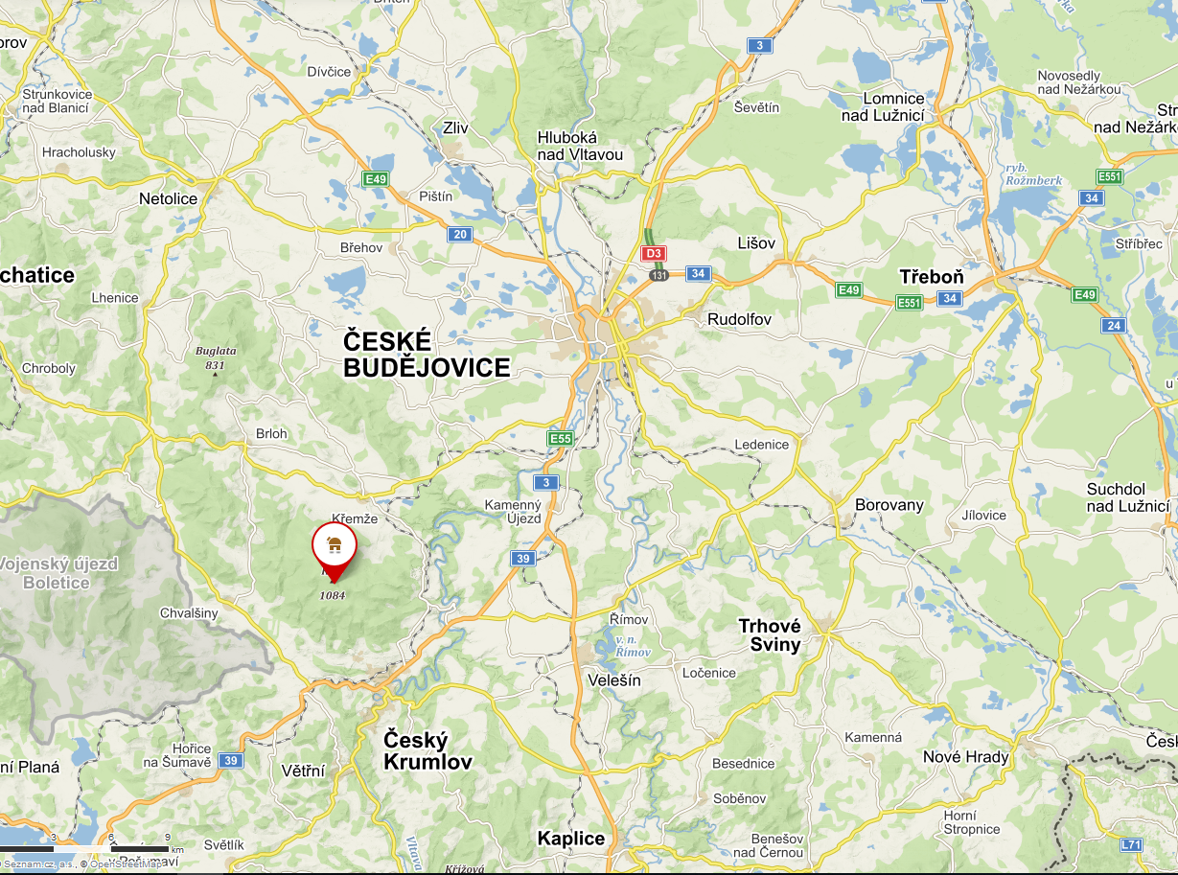
SOUTH BOHEMIA REGION KLEŤ
LOCATION
Map of the country
Map of the area with other sites

Slide 3
SOUTH BOHEMIA REGION KLEŤ
TYPE OF SITE
The highest point of Blanský forest.
PHYSICAL AND AESTHETIC FEATURES
There is also an observatory and a lookout tower with the same name.
AREA COVERED
Kleť is 1084,2 metres high. Blanský forest covers 212,35 km².
HISTORICAL/SCIENTIFIC/ARTISTIC INFORMATION
It was built between 1957 and 1958. A very famous scientist works at this observatory.
DATING
The first mention about the mounitain was written in 1263.

Slide 4
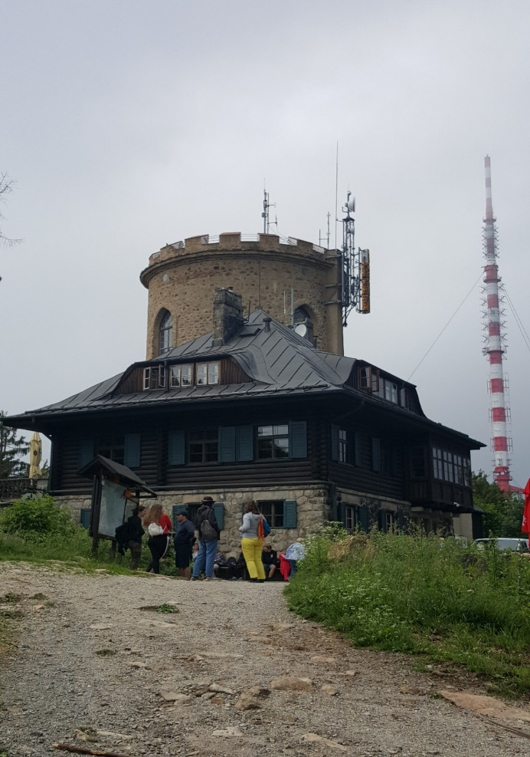
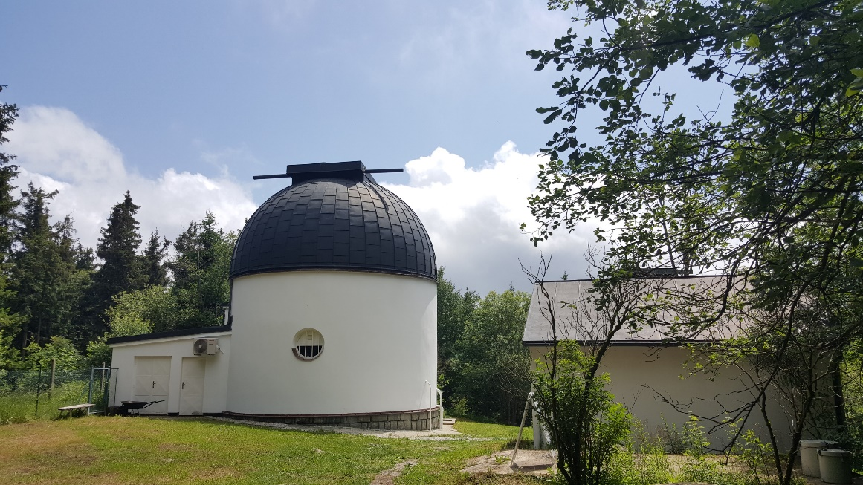
SOUTH BOHEMIA REGION KLEŤ
HIGHLIGHTS
Tereza‘s Cottage with a lookout tower
Observatory

Slide 5
SOUTH BOHEMIA REGION KLEŤ
CONDITION OF PRESERVATION
The lookout tower was reconstructed in 2008.
VISITING TIME
Up the hill Kleť you can go whenever you want.
The cable railway goes every hour and from 21.5. to 26.6. it goes at weekends, on Wednesdays, Thursdays and Fridays. From 27. 6. to 2.9. it goes on weekends and on Mondays and Fridays.
The opening times of Tereza‘s cottage is Tuesday till Friday from 10:30 to 17:00. At the weekends it is open from 9:00 to 17:00.
The observatory is opened in July and August.
LEGAL OWNERSHIP
The Kleť hill is in the ownership of the Lesy ČR .
JUDr. Ladislav Faktor is the owner of Tereza‘s cottage and of the the lookoutower.
The observatory is owned by the Southbohemian region.

Slide 6
SOUTH BOHEMIA REGION KLEŤ
ACCESSIBILITY
There is no access for the disabled people.
 | To the top and back | To top | Back
Full | 150 | 100 | 80
Sale 1- students, seniors | 90 | 60 | 50
Sale 2 – ZTP, bike | 60 | 40 | 30
Group | 400 | 250 | 300
FACILITIES
On the top there is Tereza‘s Cottage. There is a restaurant with toilets and you can also sleep there. They offer two rooms, where you can sleep.

